Slide 1
Capstore Project
By: Tisha Arora

Slide 2
CapStore
Notes:
Usar para separador de capitulos . Seria bom ter esta versao em vermelho e verde tb..

Slide 3
Modules Assigned:
Login/sign up (Merchant) (Module 1)
Login/Logout/session (Module 2)

Slide 4
Software Used:
JDK 10
Spring Boot 2.x
My SQL 5.x
Spring Tool Suite 3.9.x
Spring Boot Data
Spring Boot RestController
JSP – FrontEnd
Junit - Unit testing
User Stories by using Gherkin
Cucumber StepDef
Selenium – Integration testing
Jenking – Build Server
SonarQube – Code Quality
Git - Source Code Repository
Postman

Slide 5

Login/SignUp
These 2 modules deals with the Login, Registration and Logout activities for new and existing merchants.
There is registration page for merchant where he can register and create a new account. On creation of new account a verification mail is sent and after clicking on link and verifying it only then the merchant account is created.
The merchants can also be register to the capstore by providing their details only after the verification from admin end the merchant is validated for performing business activities.
The admin need not register and can login directly.
Notes:
O Logo de espadas deve ter mais espaço das pontas abaixo. Sugerir outros tipos de imagens/ telefone, fones.

Slide 6
Tables Used
Merchant

Slide 7
Merchant Table
Column Name | Data type | Constraint | Description
merchantId | int | Primary key Auto Generated | Used for unique identification
merchantName | varchar | NotNull
phoneNumber | int | NotNull
emailId | varchar | unique | Will be Used for merchant Login
companyName | varchar | NotNull
Password | Varchar | NotNull | Authentication purposes
Address | varchar | Foreign Key
Status | Varchar | NotNull | To let know if user is active or not
isCertified | Boolean | NotNull | Is the Merchant CapStore Certified or Not
isValidated | Boolean | NotNull | Is the Merchant CapStore validated by admin or not
Notes:
Fixar a posicao do titulo – sempre do lado esquerdo.
Sempre que tiver muito texto o coluna deve sempre ser “ narrowed” , se nao fica dificil de ler. Colocar paragrafos no texto.
Linha vertical deve ser mais fina e as pontas NUNCA devem ser arredondadas.

Slide 8
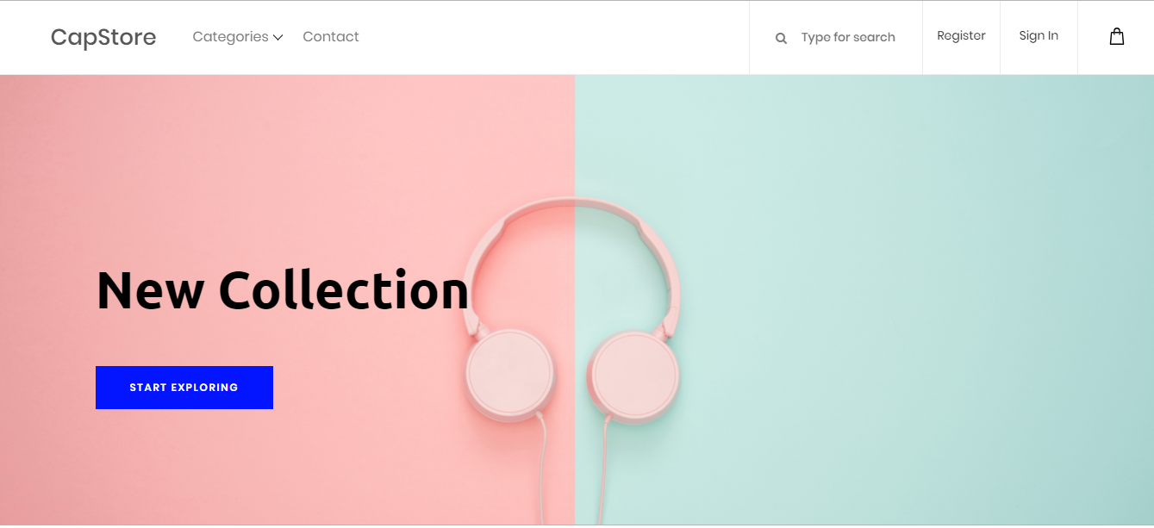
Capstore Homepage

Slide 9
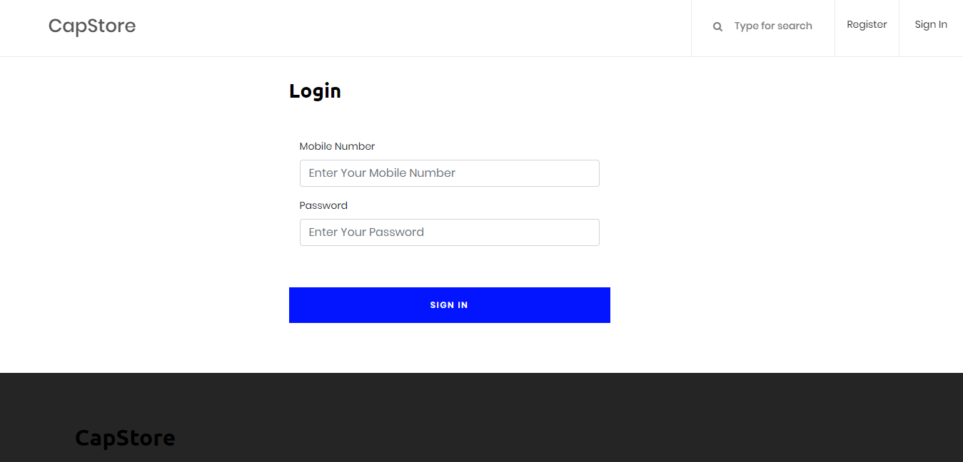
Login Page

Slide 10
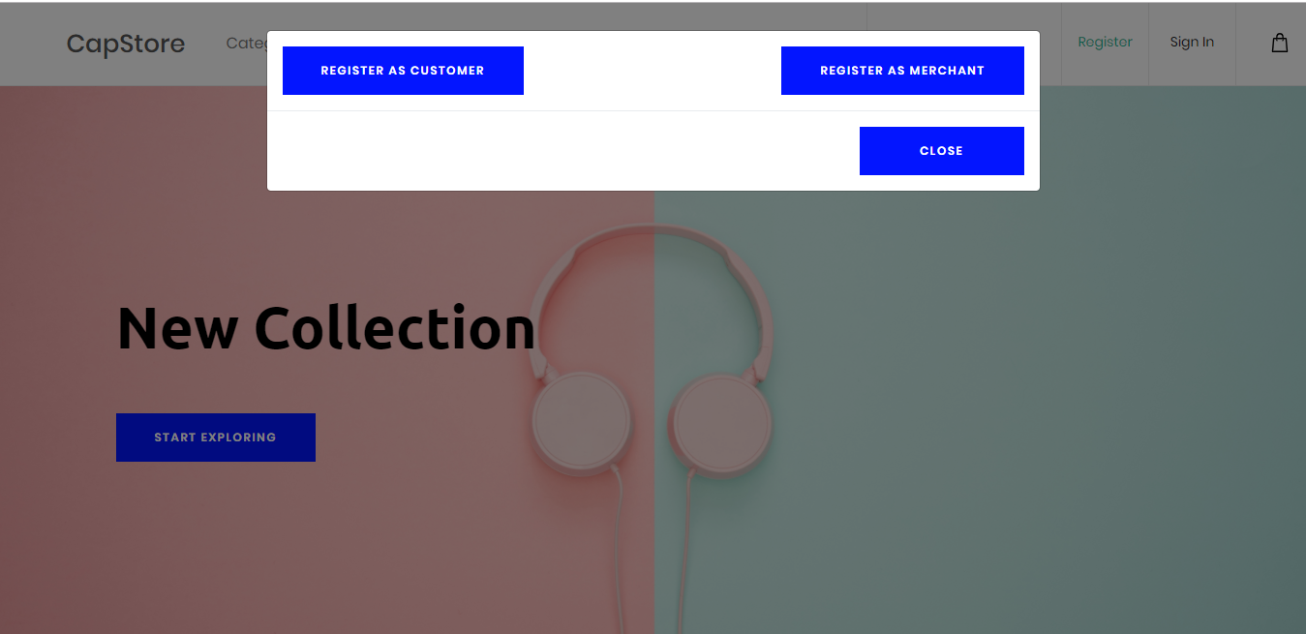
Merchant SignUp Option

Slide 11
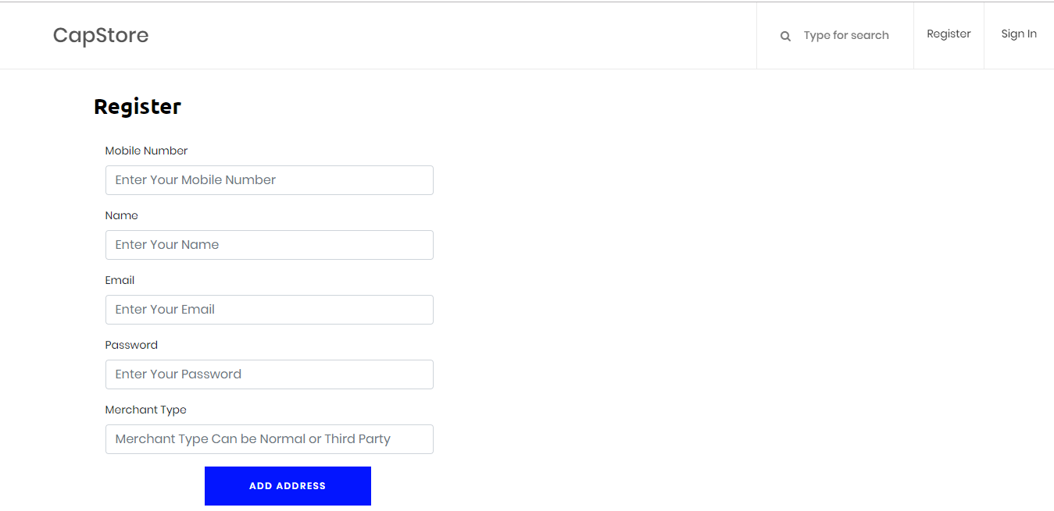
Merchant SignUp Page

Slide 12
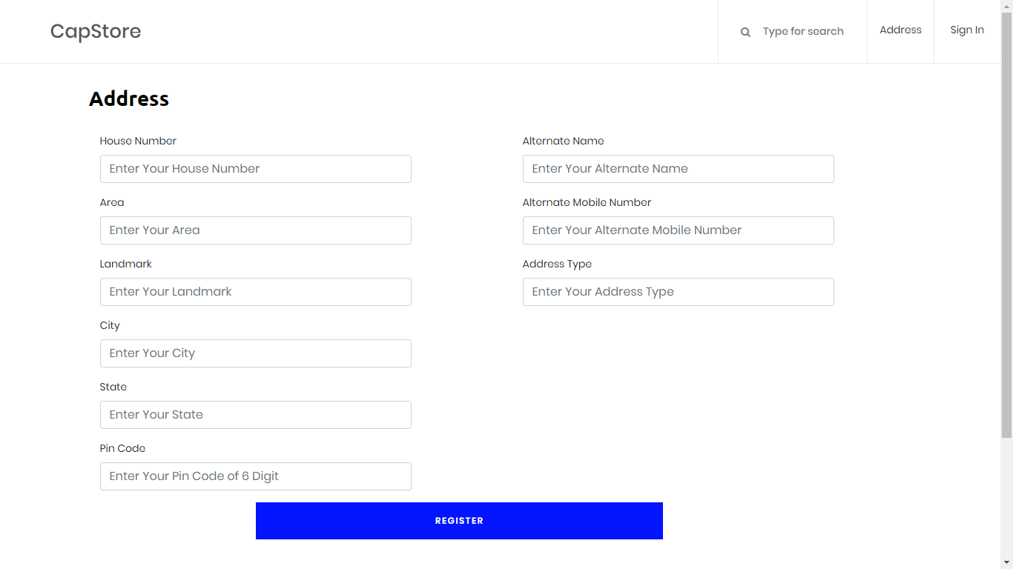
Merchant SignUp Page

Slide 13
Thank you
Notes:
O Box atras do texto desnecessario. Deixar o layout mais simples.

